Slide 1
SkipTheDishes Tech Challenge
Data Engineer Miller Carvalho

Slide 2
Topics
Database Solution
Identify areas to expand the service
Moving environment to the Cloud

Slide 3
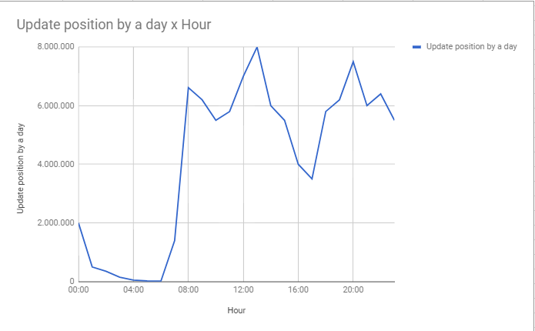
Database Solution
● Sample Graph Estimation - Update position by a day x Hour graph:

Slide 4
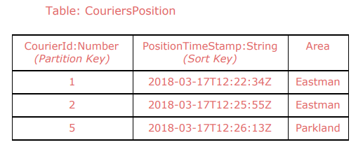
Database Solution
Use DynamoDB - multi-model, schemaless, scalable, auto-managed and provisioned read/write capability @ AWS;
Table Model:

Slide 5
Database Solution
Considering that will be exponential growth we could:
First: auto-scaling - could be expensive, but you can enable just to see the right behavior;
Second: DynamoDB must be able to write 3.333 events per second.
It will works if you provision 3.333 units to write per second in a table that will modeled to able cover courier’s system for the next 6 months.

Slide 6
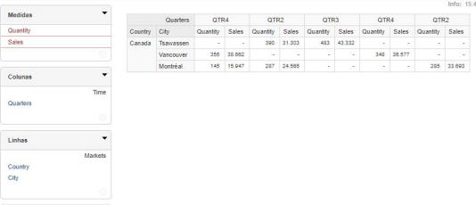
Identify areas to expand the service
You can use Redshift to copy DynamoDB’s data, and you could perform SQL queries;
You can use a OLAP engine like Pentaho Mondrian to see your data in multidimensional model (cubes), like image below:

Slide 7
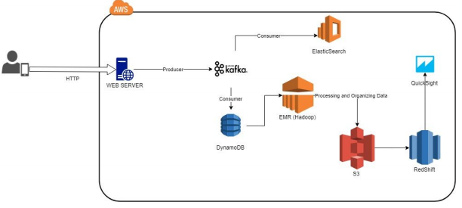
Moving environment to the Cloud

Slide 8
Moving environment to the Cloud
Kafka to stream events. You should keep the last 24 hours of events for a lot of consumers that wants to make near real-time decision or insert data into relational databases or DynamoDB;
DynamoDB to persist data;
Hadoop (EMR) to process distributed events in large scale, organizing data and record them into S3;
Redshift (Columnar Database) will get S3’s organized data to datawarehouse purposes (S3DistCP);
QuickSight for analytics, reports and dashboards;
Elasticsearch to keep events to be able to full text search events (for segmentation issues).

